Slide 1

A Reverse Vending Machine using open cv method
Chaitanya Bharathi Institute of Technology
Department of ECE
Under the guidance of, Project Coordinator Head of the department Mrs .A. Sandhya Deepthi, M.Tech Mr.C.Md. Aslam,M.Tech(Ph.D),MISTE,ISTE Dr. M.Lakshmi Kiran,M.Tech,Phd
Assistant Professor Associate Professor,Co-Ordinator Professor, Dept of Ece
Presented by:
V. Kamal Basha(192P1A04A5)
N. Jhansi(192P1A0470)
P. Bhavitha (192P1A0483)
P. Chandrahas Sharma(202P5A0410)
N. Naveen Kumar(192P1A0474)

Slide 2
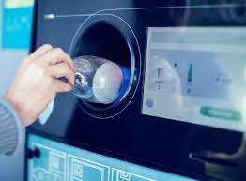
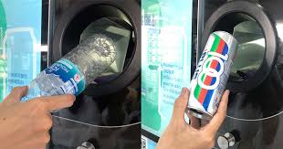

Slide 3
A Reverse Vending Machine using open cv method

Slide 4
CONTENTS
Abstract
Introduction
Literature Survey
Block Diagram
Hardware Components
operation
Software Tools
Advantages
Applications

Slide 5
Abstract
The main theme of Reverse vending machine using open cv method is to avoid the plastic bottles in the surroundings. By using this machine, the people can collect and dispose the surrounding PET bottles and will be provided an incentive as a chacolate. In this module we used the programming tool like python for getting the accurate results. Apart from this the Reverse vending machine will help to reduce the soil pollution in the environment from the hazardous non-recyclable PET bottles.

Slide 6
Introduction
The Revese vending machine using open cv method is a simple semi automated mechatronics device.
Which is developed using the raspberry-pi technology.
In this machine we have arranged a camera which used for identifying the type of material for collecting the plastic bottles.
The image is scanned by the camera module which is interfaced to the raspberry board.
The scanned item is identified as a plastic then it will drop into Bin otherwise the lid not open.
If the item is received in Bin-1, it provides a chocolate as a compliment to the person.

Slide 7
Literature Survey
This literature survey will focus on the reverse vending machine for sorting PET bottles.
ADITYA GAUR, DILIP MATHURIA, DR. RASHMI PRIYADARSHINI PROPOSED “A SIMPLE APPROACH TO DESIGN REVERSE VENDING MACHINE", INTERNATIONAL JOURNAL OF ELECTRONICS, ELECTRICAL, AND COMPUTATIONAL SYSTEM IJEECS ISSN 2348-117X VOLUME 7, ISSUE 3, MARCH 2018.
This paper presents a simple approach to design a Reverse vending machine.
The system is cost effective in implementing the design because of the sensors like capacitive proximity sensor, an infrared photoelectric sensor and strain gauge weight sensor.
The challenges and scopes of this work are : Improved detection accuracy of the sensor system , Lower energy consumption.

Slide 8
“REVERSE VENDING MACHINES FOR EMPTY BEVERAGE CONTAINERS IEEE: A REVIEW" BY DE SCHRYVER ET AL. (2019)
Future Scope :
• Reduced energy consumption.
• Implement image recognition procedures in RVM.
• Improves the detection accuracy of the sensor system.

Slide 9
BLOCK DIAGRAM
Raspberry
Pi
(pico)
Servo
motor
Camera
IR
Sensor
Buzzer
USB TTL
RPS

Slide 10
HARDWARE COMPONENTS
Raspberry Pi (Pico).
RPS(Regulated Power Supply).
Camera.
Servo Motor.
Buzzer.
IR Sensor.
USB TO TTR Converter

Slide 11
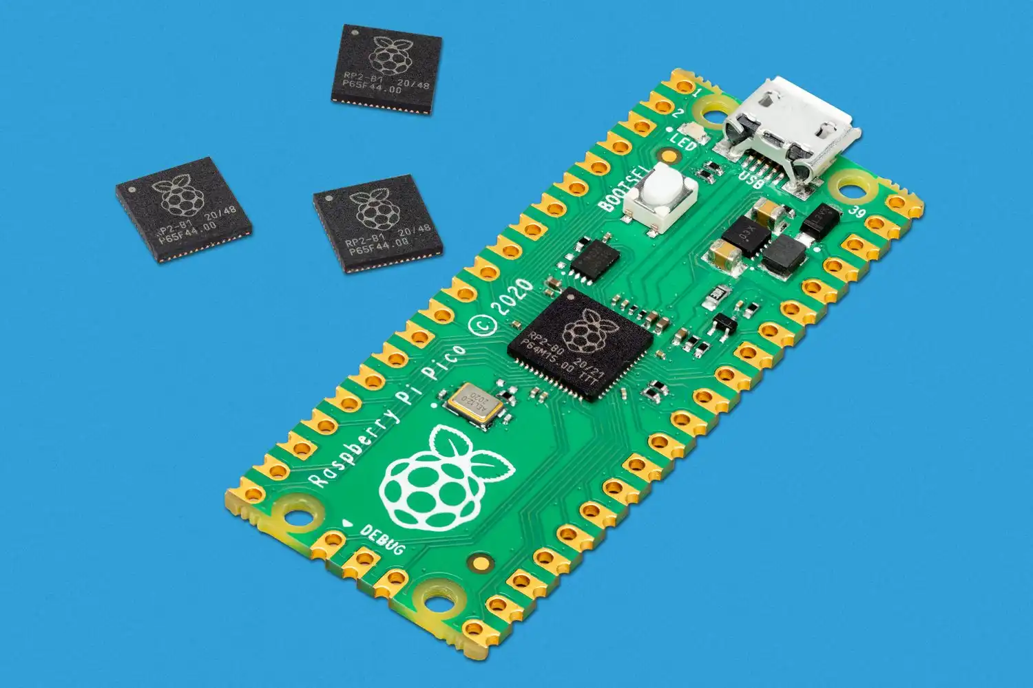
Raspberry Pi (pico):- Specifications:-
21 mm *51 mm form factor
Rp2040 microcontroller chip designed by raspberry pi in the UK.
Dual-core Arm Cortex-M0+ processor,flexible clock running up to 133MHZ.
264KB on-chip SRAM.
2MB on-board QSPI flash.
2.4GHZ 802.11n wireless LAN(Raspberry pi pico W and WH only)

Slide 12
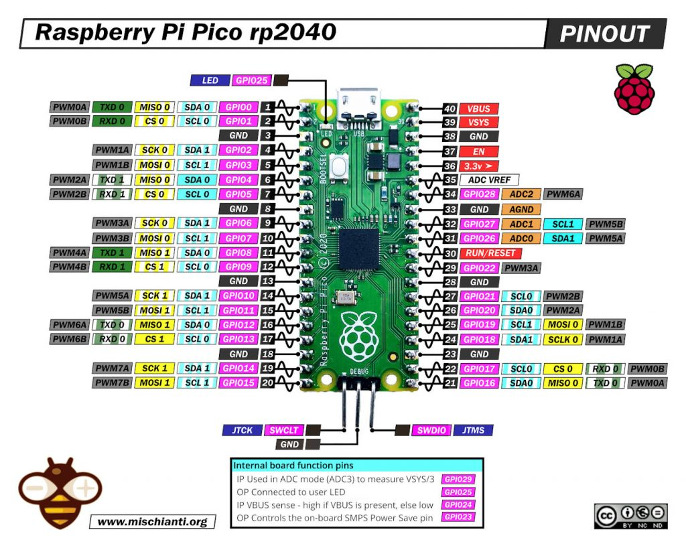
Pin diagram

Slide 13
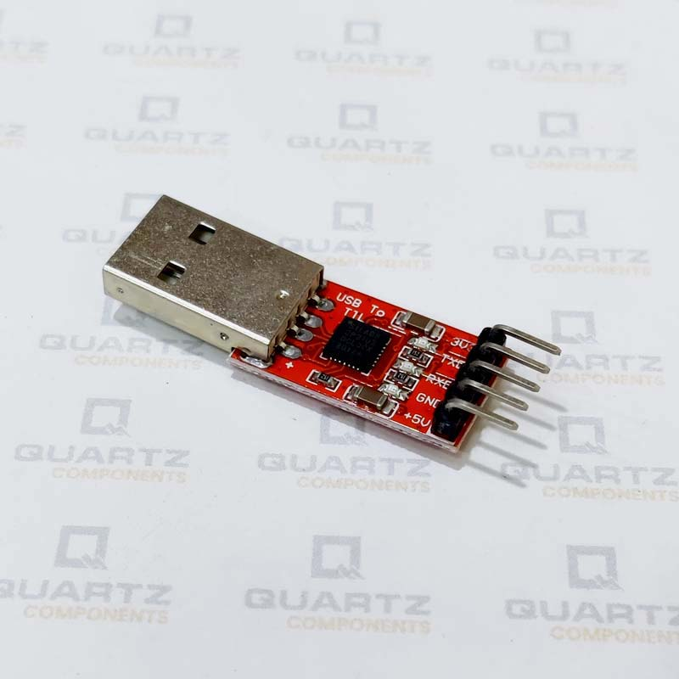
USB to TTL converter
The USB To TTL Converter cable allows us to connect any serial port to device enabling the mobility
This cable is used for temporary TTL Converter applications such as for transmission,settings,debugging in various electronics devices

Slide 14
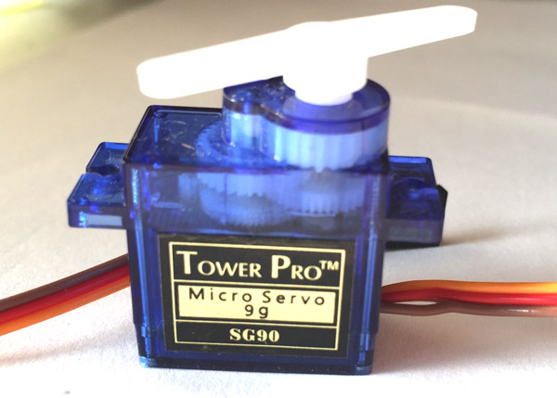
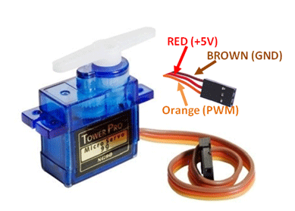
Servo Motor.
Servo Motor Features:-
Operating Voltage is +5V typically
Torque: 2.5kg/cm
Operating speed is 0.1s/60°
Gear Type: Plastic
Rotation : 0°-180°
Weight of motor : 9gm
Package includes gear horns and screws

Slide 15
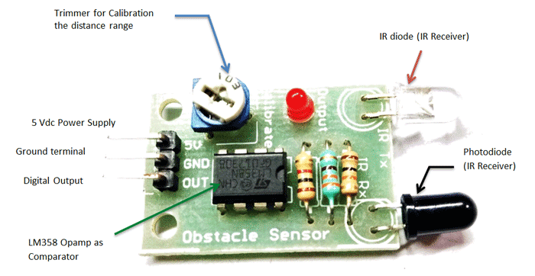
Ir sensor
IR Sensor Module Features
5VDC Operating voltage
I/O pins are 5V and 3.3V compliant
Range: Up to 20cm
Adjustable Sensing range
Built-in Ambient Light Sensor
20mA supply current
Mounting hole

Slide 16
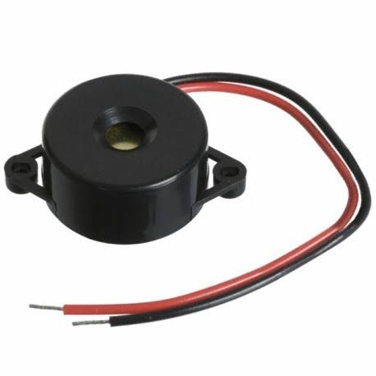
BUZZER
A buzzer or beeper is an audio signaling device, which may be mechanical, electromechanical, or electronic.
A buzzer is usually like an alarm sound
characteristics of buzzer circuit :
1. sound level -------------------70-95 dB
2. current consumption---------35-60 ma
3. resonant frequency---------- 1-3 khz

Slide 17
Flow chart

Slide 18
operation
The Reverse vending machine works on the function of Raspbeery pi microcontroller. The user come near to the vending machine and drops the plastic bottle into the vending machine based on the programming written for the module if the object is plastic then the lid of the container will open and the bottle drops inside the bin in meanwhile the Raspbeery pass the signal to the another servo motor the servo motor which near to the chocolate and it will open the lead of the chocolate container and drops the chocolate and the user will collect that or else if the object is identified as a non plastic the servo motor doesn’t open the lid of the servo motor at the both ends of the containers.

Slide 19


Software tools
Python
Image Processing

Slide 20

Python
Embedded Python is an extension of the Python
programming language that allows for execution
of Python code inside the InterSystems IRIS process
context.
Because Embedded Python shares the same
process context as ObjectScript, it can interact
natively with objects written in ObjectScript.

Slide 21

Image processing
Digital Image Processing is a software which
is used in image processing.
For example: computer graphics, signals,
photography, camera mechanism, pixel

Slide 22
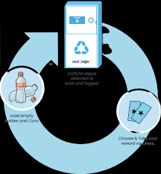
ADVANTAGES
Most Convenience
Cost Savings
More Environmental Benefits

Slide 23
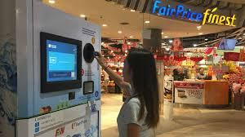
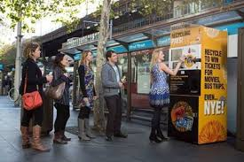
APPLICATIONS
Colleges.
Malls.
Cinema Halls.
Bus stand.
Railway Station.

Slide 24
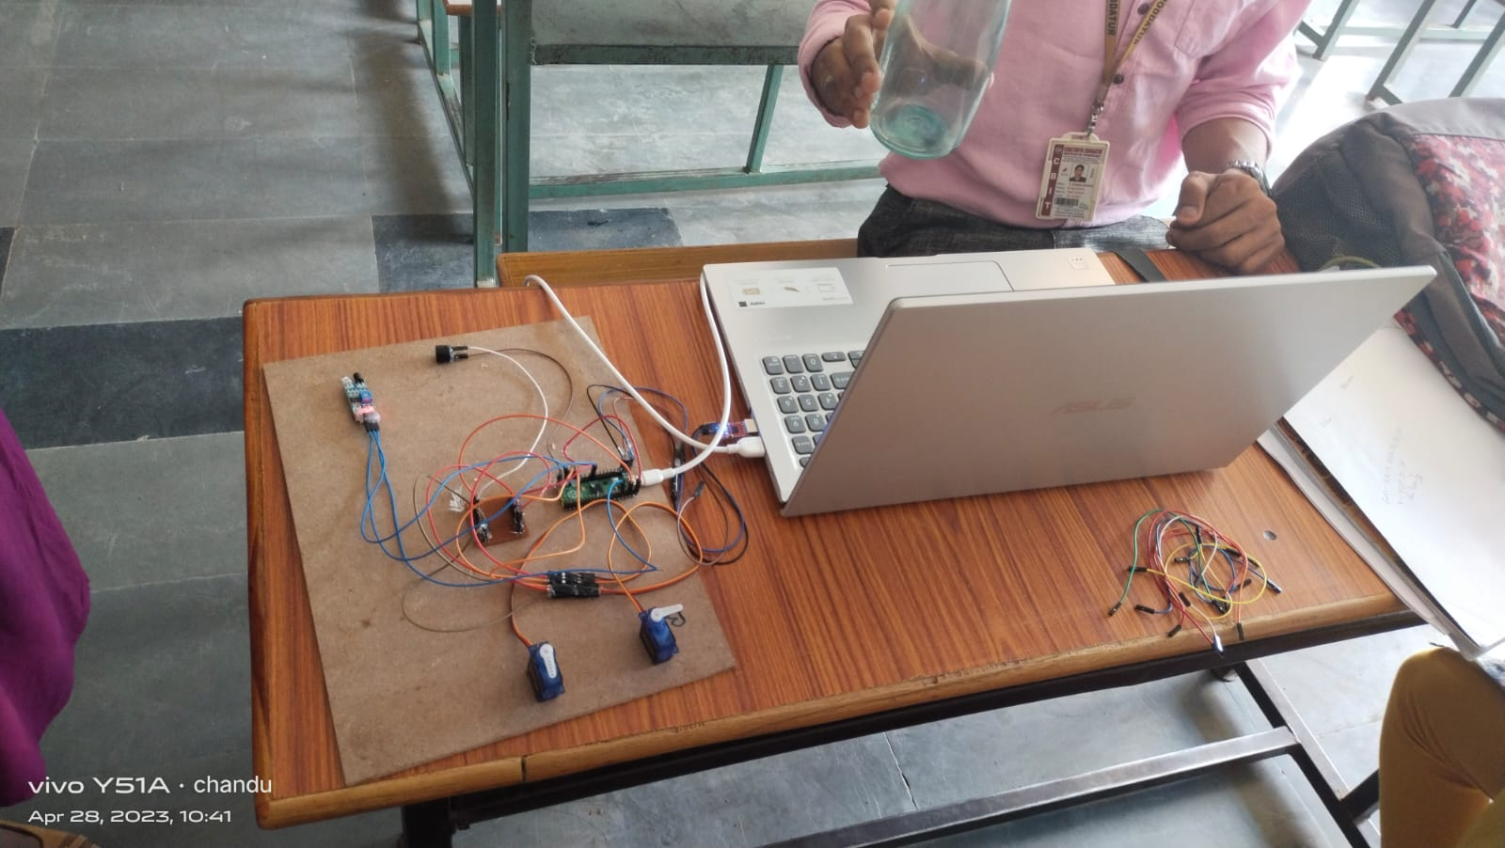
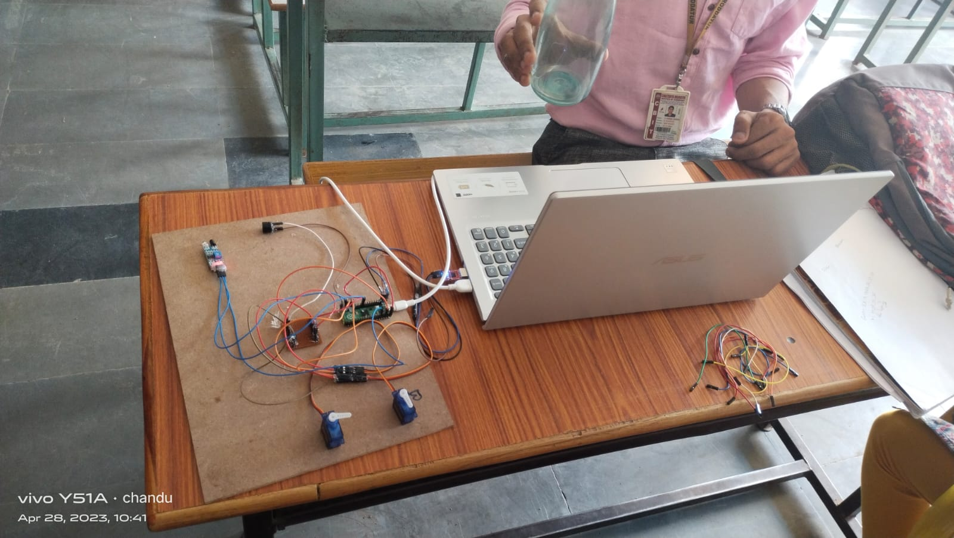
Result

Slide 25
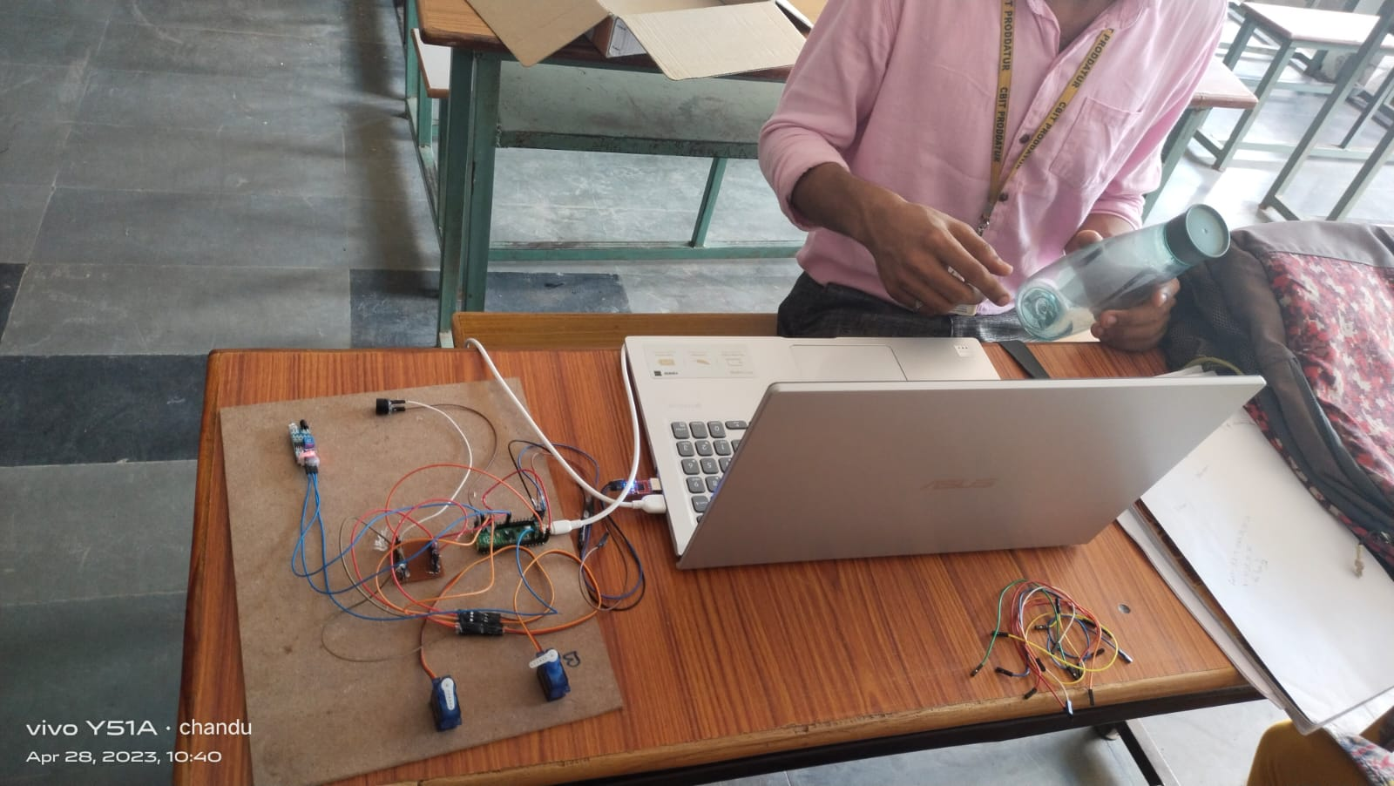
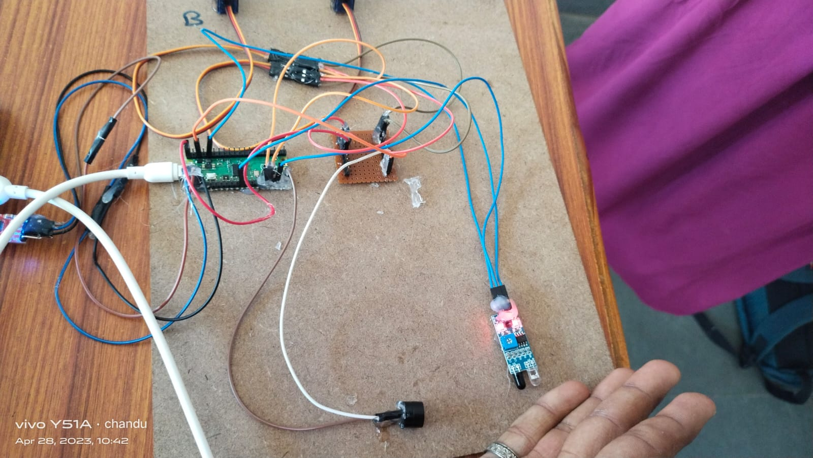

Slide 26


Slide 27


